Slide 1


Under-Counted Tensor Completion with Neural Side Information Learner: Recoverability and Algorithm
Shahana Ibrahim, Xiao Fu, Rebecca Hutchinson, Eugene Seo
SIAM OP23

Slide 2
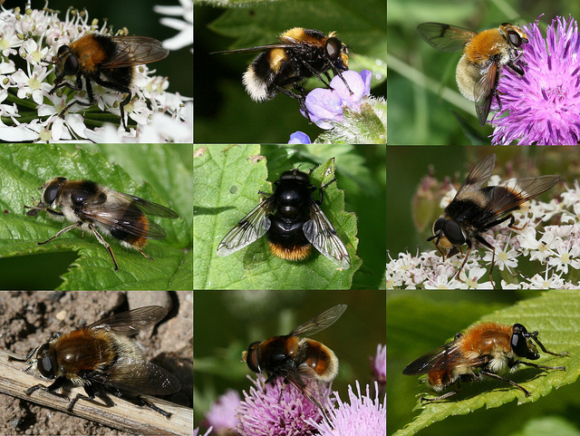
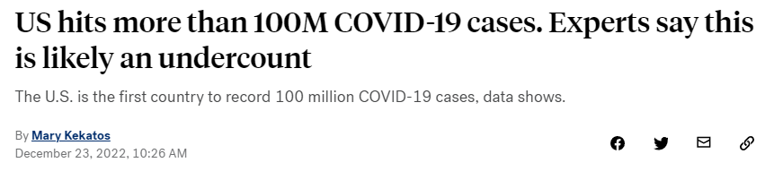


Under-counted Data
https://www.newphytologist.org/blog/scanning-the-genetic-barcode-of-plant-pollinator-interactions/
https://abcnews.go.com/Health/us-hits-100m-covid-19-cases-experts-undercount/story?id=95748100
https://www.pennmedicine.org/news/news-releases/2019/september/ minority-students-still-underrepresented-in-medical-schools
Plant-Pollinator Interactions
COVID-19 cases
Underrepresented Population
Only a small portion of the actual activities may have been observed
Symptom-free patients or lack of testing can cause under-reporting of cases
Underrepresented population is reported to be heavily under-counted in census
Notes:
Add citations for all these

Slide 3

A natural question is:
How can we estimate the true-counts?

Slide 4
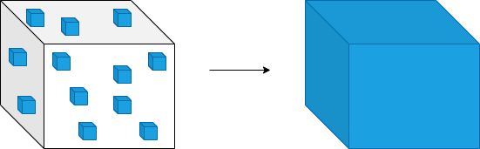
Tensors Meet Under-counted Data
Tensors are powerful tools for multi-aspect data analytics
Tensor with Partial Observations
Complete Tensor
Tensor
Completion
Under-counted tensor completion (UC-TC) is less studied in literature

Slide 5
Existing Approaches for Under-counted Data
Under-counted Matrix Completion
Observed entries are either zeros or true-counts
Zero-inflated Poisson Models
Liang et al., 2016 Billio et al., 2022 Simchowitz, 2013 Durif et al., 2019
Fu et al., 2021
Observed entries are less than or equal to true-counts
General
under-counted Data

Slide 6
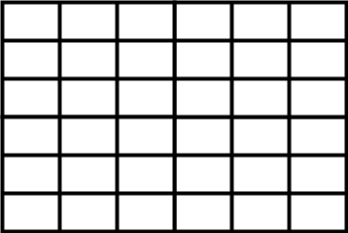
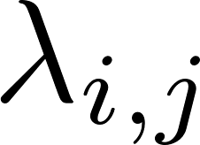
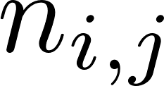
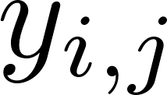
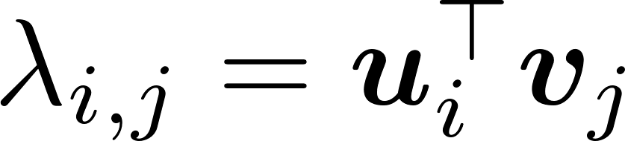
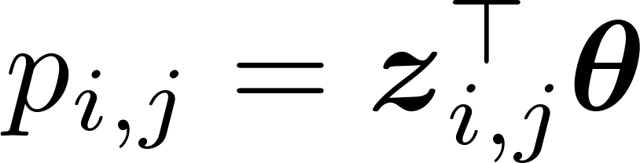
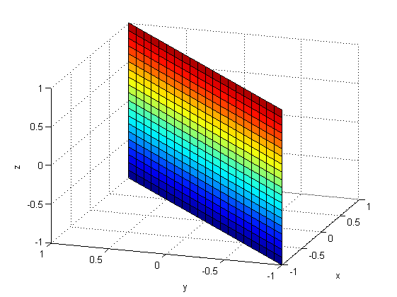
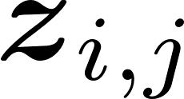
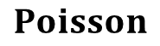

UC-MC Model [Fu et al., 2021]
Under-counted observations
True-counts
$$Poisson$$
$$Binomial$$
Detection Probability
Low-rank matrix factorization model
Linear function
Features
e.g., location, temperature, humidity

Slide 7
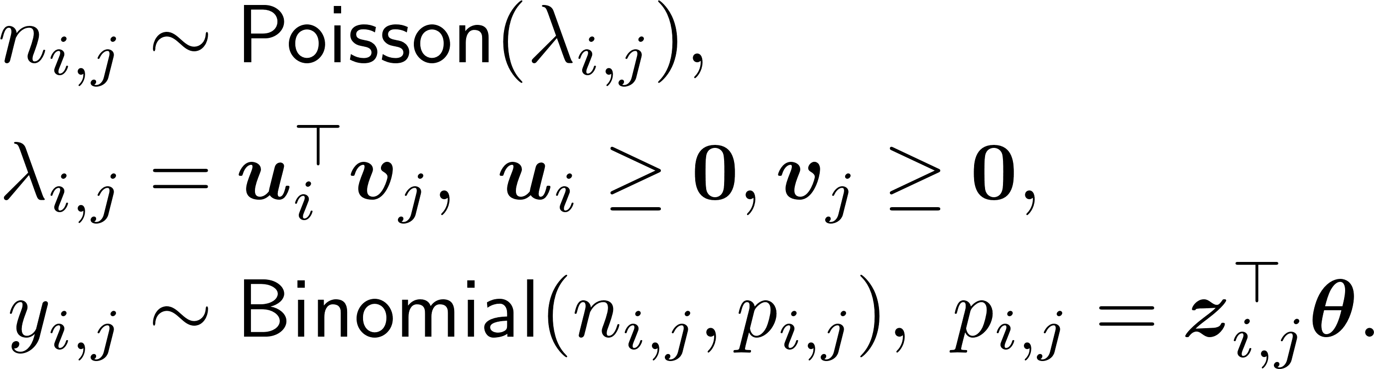
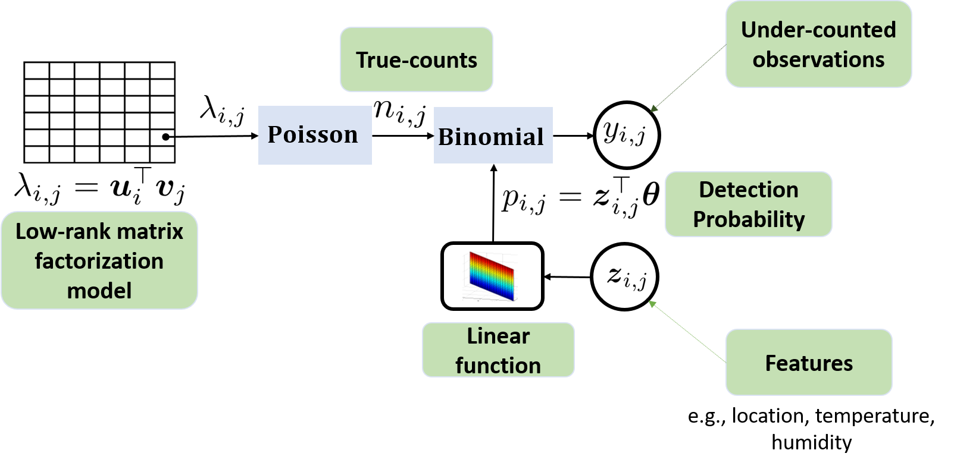
UC-MC Model [Fu et al., 2021]

Slide 8
Our Goal
Tackle the existing challenges in under-counted data analysis
Effective modeling for general under-counted data
Tensor modeling for multi-aspect data
Nonlinear modeling for complex feature-detection relations
Provable learning of the true-counts and detection probabilities

Slide 9

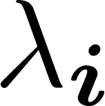
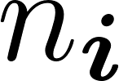

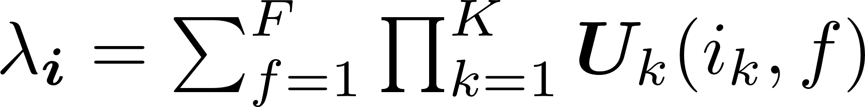
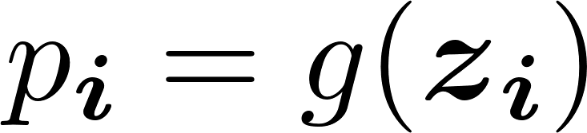
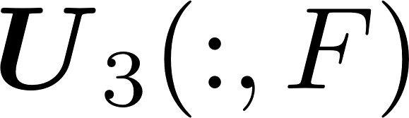
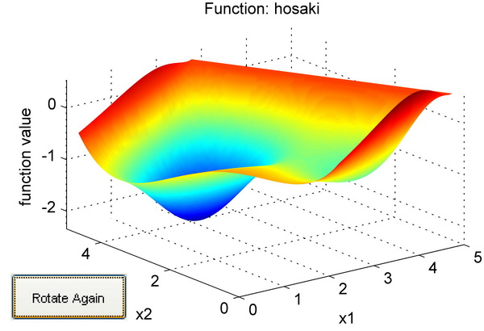
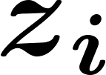
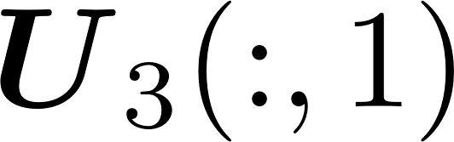
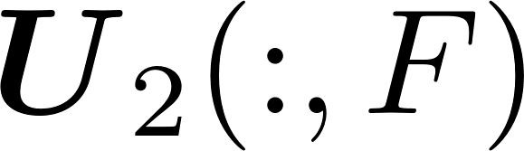
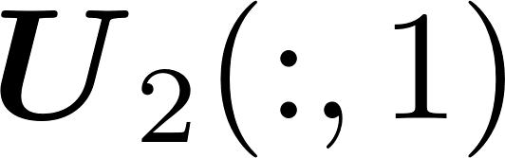

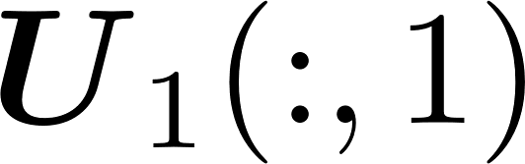
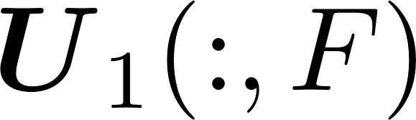
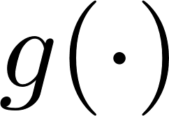

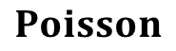
Proposed UC-TC Model
Under-counted observations
True-counts
$$Poisson$$
$$Binomial$$
Detection Probability
Non Linear function
Features
Low-rank tensor factorization model
e.g., location, temperature, humidity

Slide 10
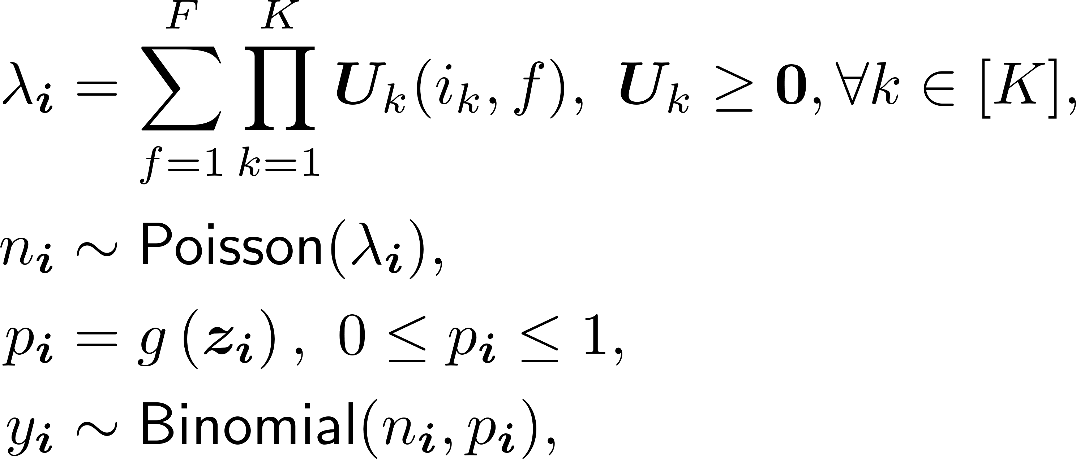
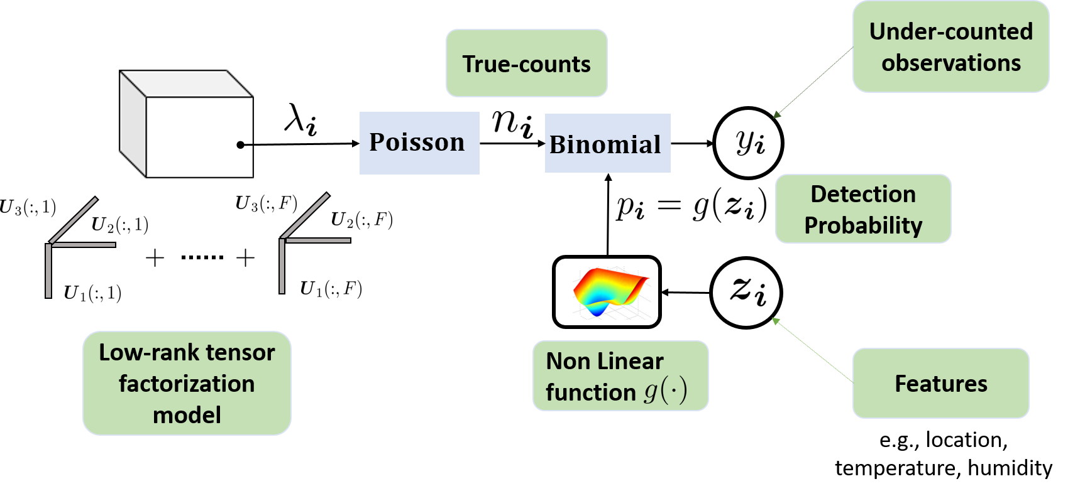
Proposed UC-TC Model

Slide 11
Q: Given a few under-counted observations and a set of features, can we recover the true counts and the detection probabilities for all tensor entries?

Slide 12
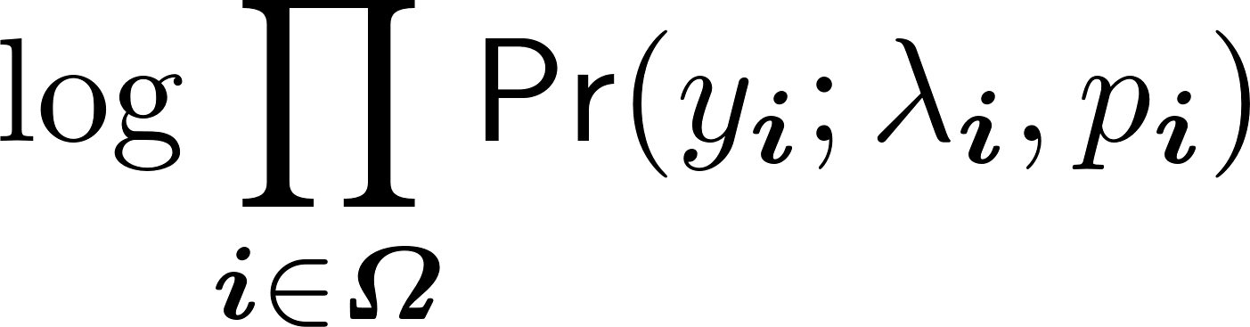
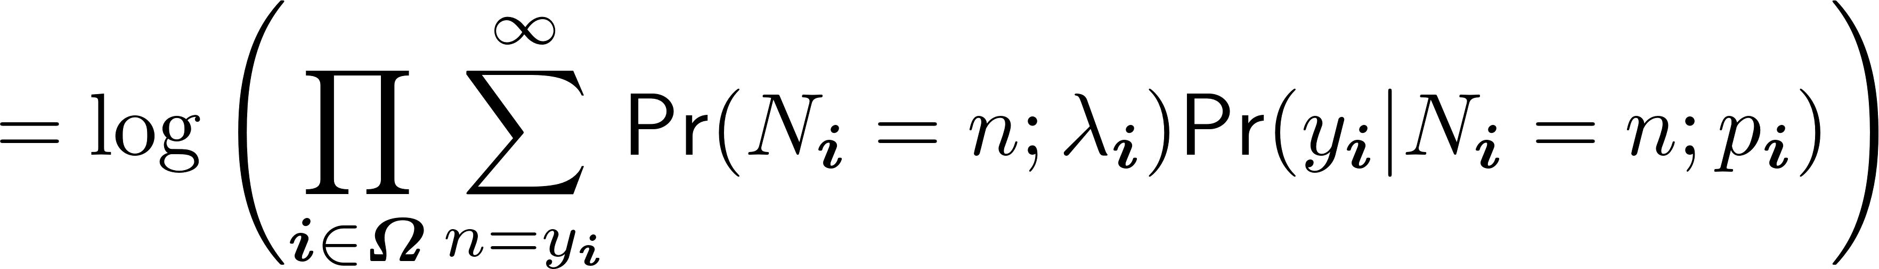
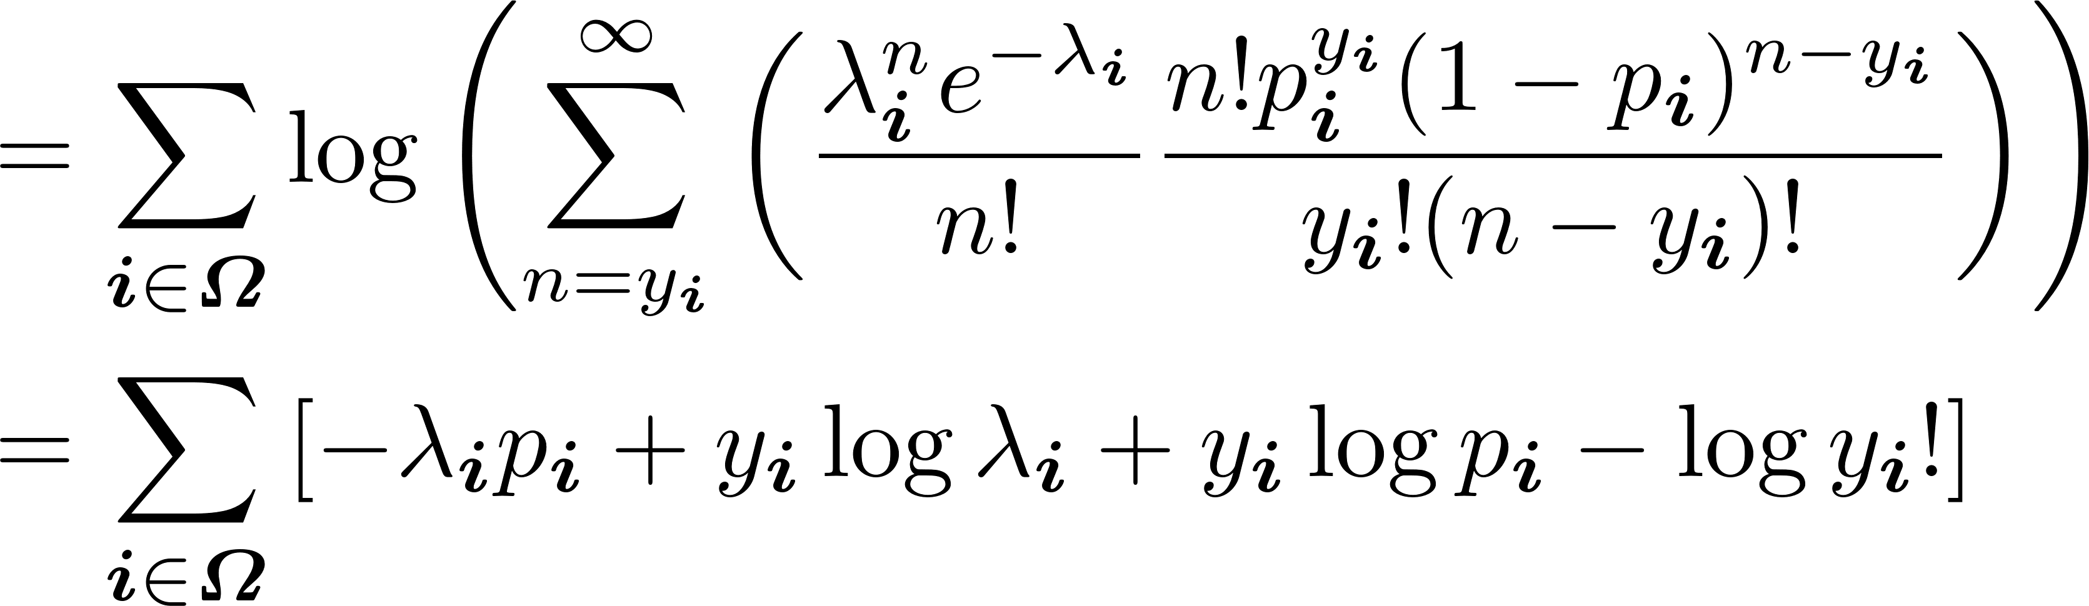
Maximum Likelihood Estimation
Indices of the observations

Slide 13
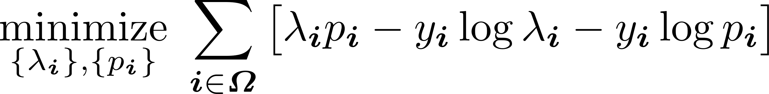
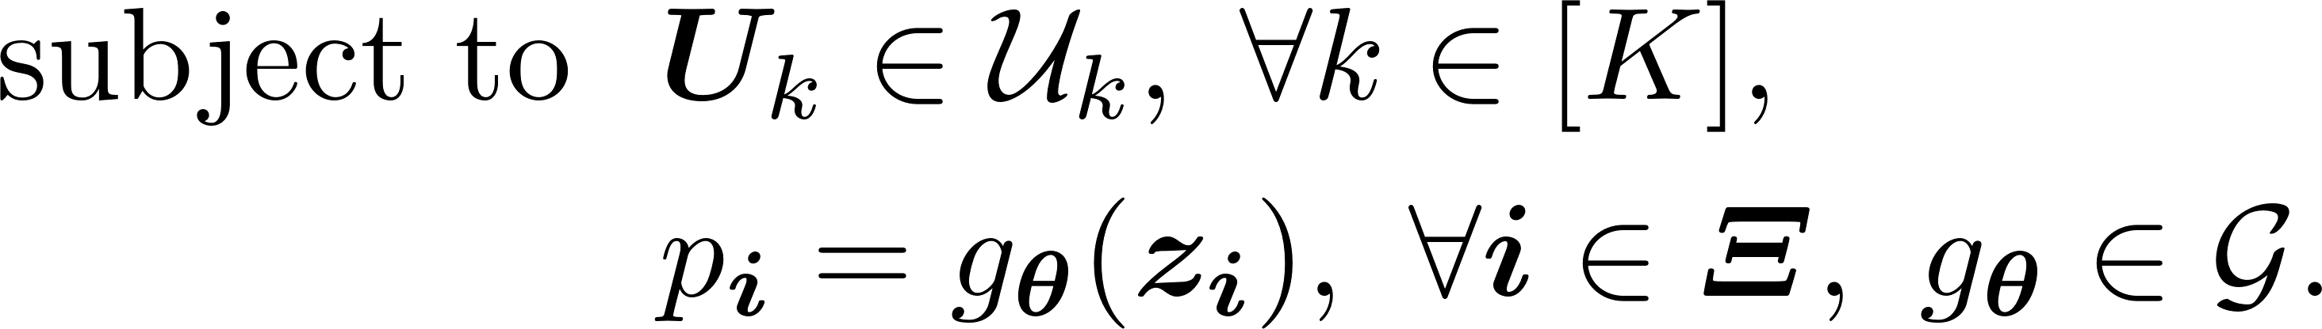
Proposed UC-TC Formulation
Indices of the observations
Constraint set for latent factors, e.g., nonnegativity
Nonlinear function class e.g., DNNs
Indices of the recorded features

Slide 14
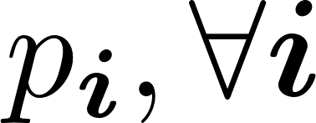
Proposed UC-TC Formulation
Q: Can this formulation provably recover
and
?

Slide 15

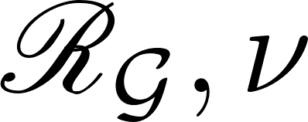

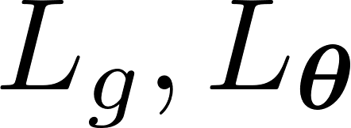
Analysis Setup
The ground truths and optimization variables are bounded
NN class is chosen to be with reasonable complexity
The ground-truth nonlinearity function and the NN functions are Lipschitz continuous
There exists a set of indices such that

Slide 16
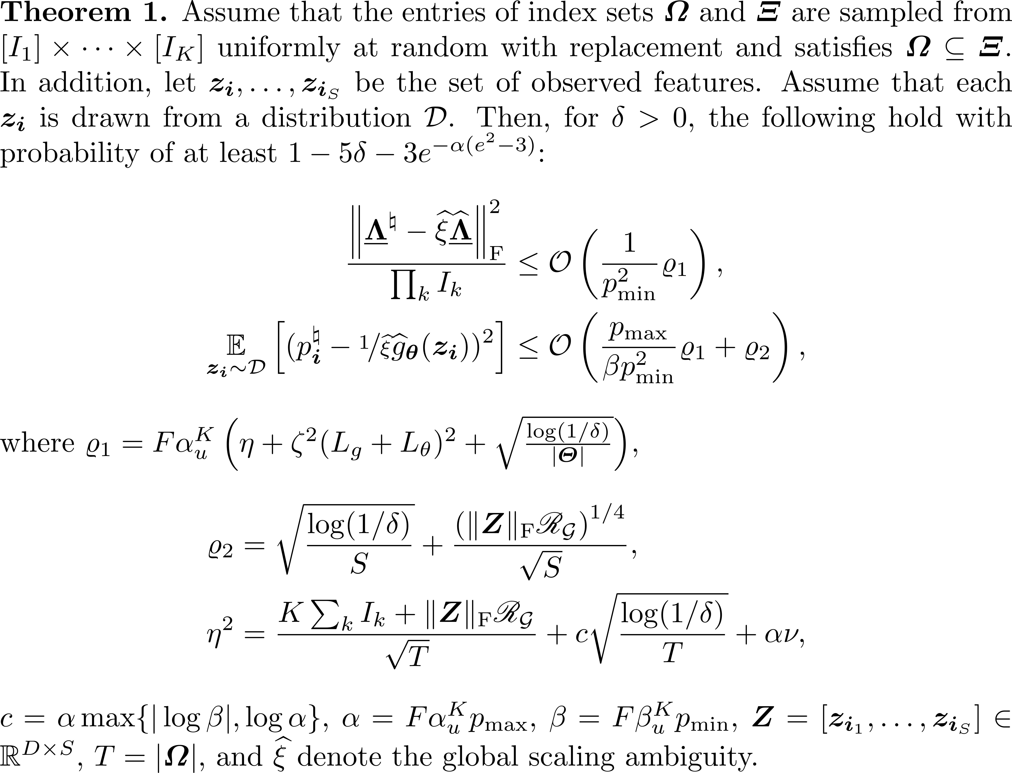
Analysis Result
True-counts and detection prob. Can be recovered
There is a global scaling/counter-scaling ambiguity
More similar features are helpful for accurate estimation
There is a trade off between the complexity of NN and est. accuracy

Slide 17
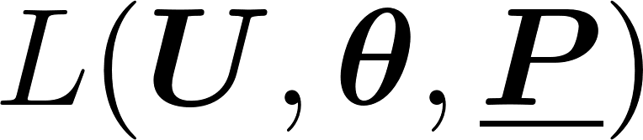

Algorithm Design
Nonnegativity
there may be some observations without features recorded or vice versa

Slide 18
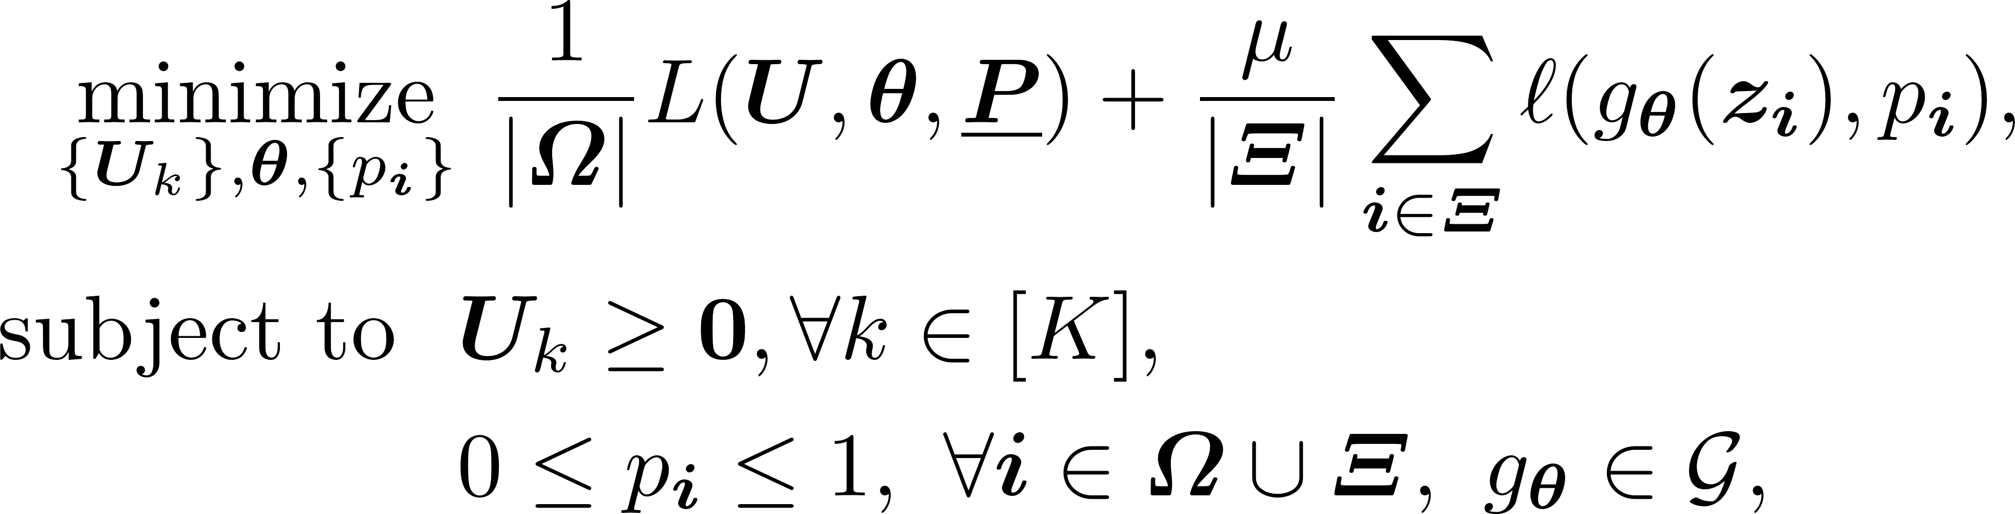

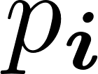


Proposed Algorithm - UncleTC
Block Coordinate Descent-based updates
updates follows majorization-minimization idea [Chi & Kolda, 2012]
Constrained convex optimization for if is convex
subproblem is an unconstrained NN learning problem

Slide 19

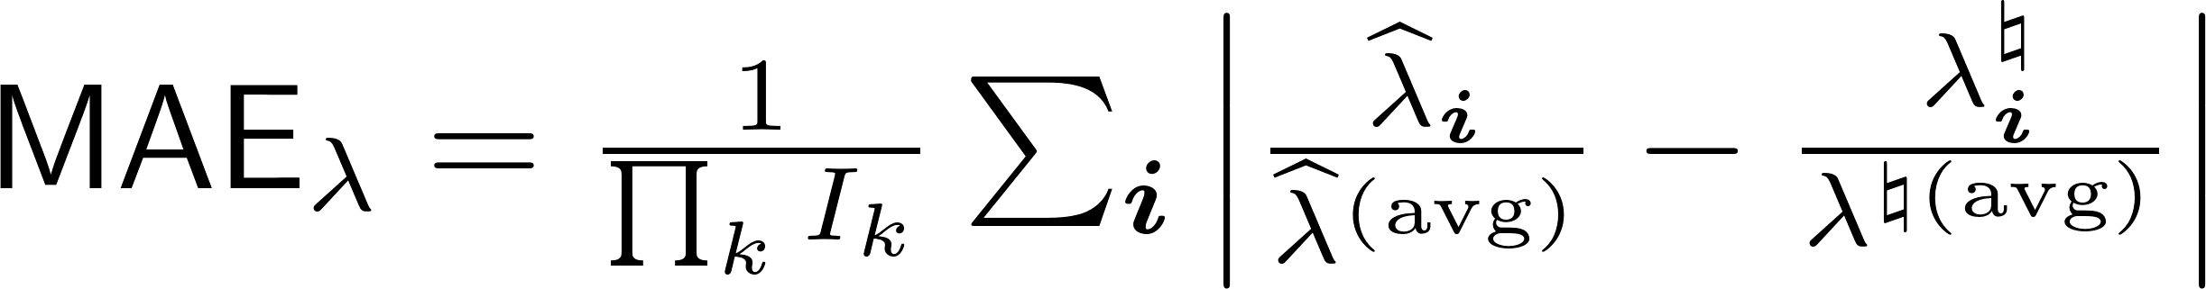

Simulation Setup
Generative Model:
Parameters:
Ground-truth nonlinearity:
NN Function class:
FCNN with 3 layers and 20 hidden units
Metric:

Slide 20



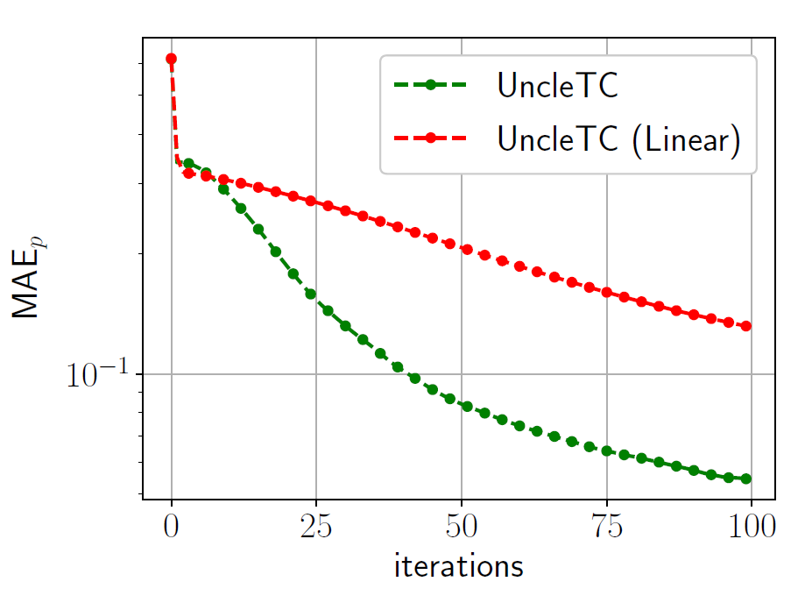
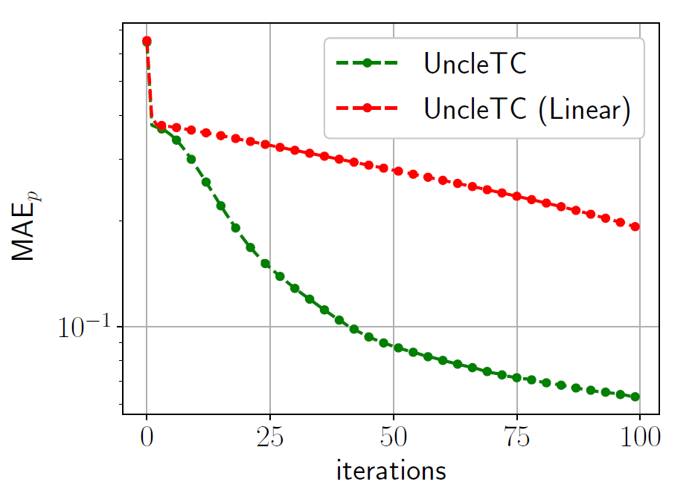
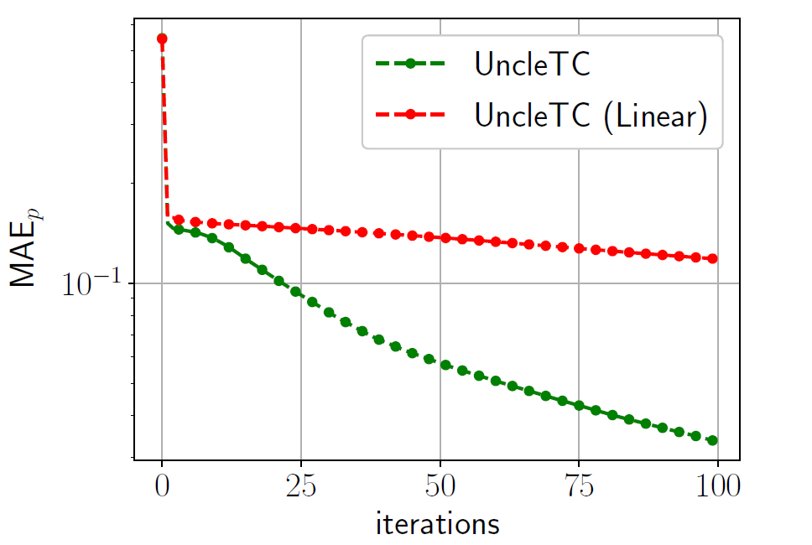
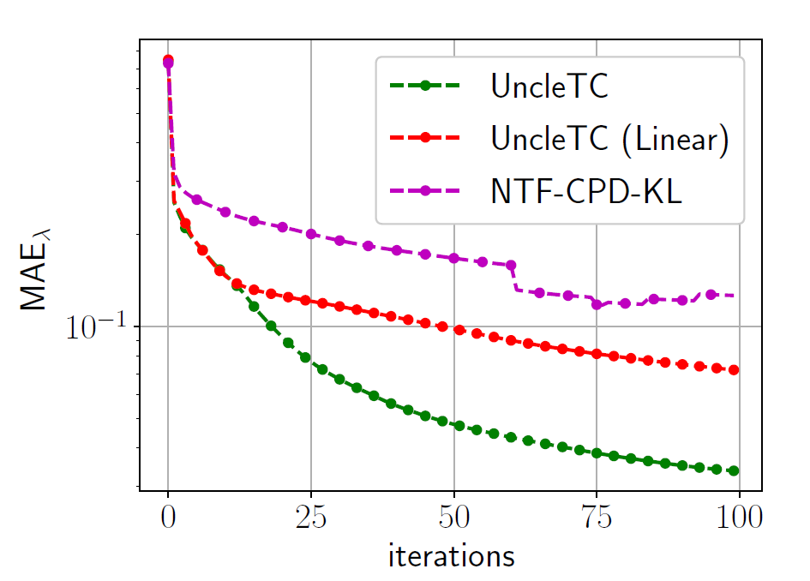
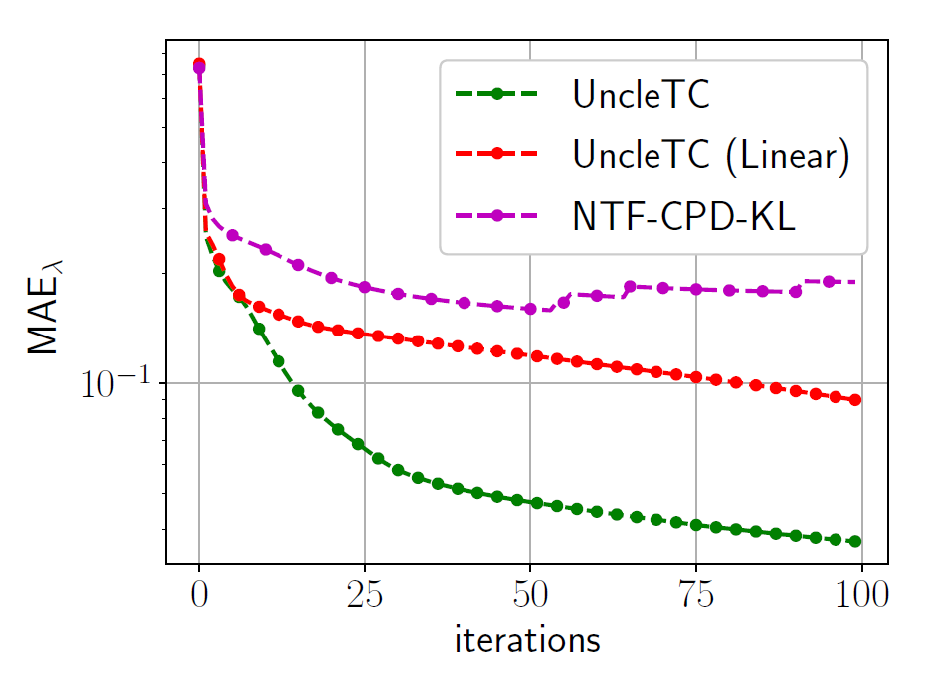
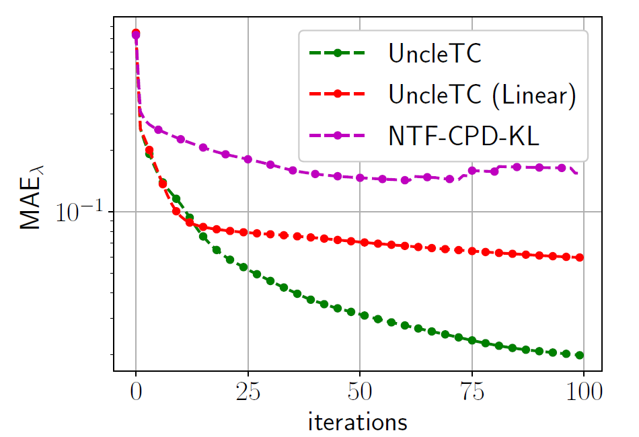
Simulations

Slide 21
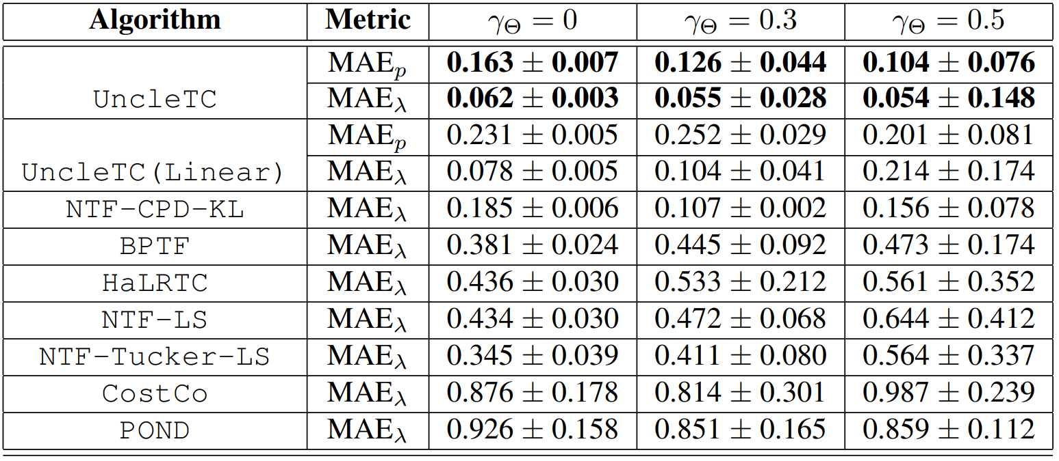
Simulations
Varying

Slide 22


Simulations
Varying

Slide 23


COVID-19 Data
Real Data
Prediction performance in terms of rRMSE
https://data.covid.umd.edu/
Tensor size 43 x 80 x 60
640 counties over 60 days
18.41 % entries observed
25 features such as social distancing index, population density, testing capacity
PPI Data
H.J. Andrews Long-term Ecological Research site in Oregon, USA
Tensor size 50 x 50 x 37
22.06 % entries observed
37 features such as flower color of the
plant, pollinator tongue length, weather conditions,

Slide 24

Real Data
Top-10 counties with high detection prob.
Top-10 counties with low detection prob.
Most counties with large detection prob.
Higher number of tests done
Populous, urban counties
There may be other factors as well affecting the detection of the cases

Slide 25
Key Takeaways
Proposed a tensor completion-based framework for under-counted multi-aspect data
Effective modeling and learning of complex nonlinear relations between latent parameters and observations
Established theoretical guarantees for learning true-counts and detection probabilities
Promising results from synthetic and real data evaluations
*Shahana Ibrahim, Xiao Fu, Rebecca Hutchinson, and Eugen Seo “Under-Counted Tensor Completion with Neural Incorporation of Attributes”, accepted to ICML, 2023

Slide 26
Thank You

Slide 27
References
Fu, X., Seo, E., Clarke, J., and Hutchinson, R. A. Link prediction under imperfect detection: Collaborative filtering for ecological networks. IEEE Transactions on Knowledge and Data Engineering, 33(8):3117–3128, 2021
Billio, M., Casarin, R., and Iacopini, M. Bayesian markov-switching tensor regression for time-varying networks. Journal of the American Statistical Association, pp. 1–13, 2022
Liang, D., Charlin, L., McInerney, J., and Blei, D. M. Modeling user exposure in recommendation. In Proceedings of the International Conference on World Wide Web, pp.951–961, 2016
Simchowitz, M. Zero-inflated poisson factorization for recommendation systems. Junior Independent Work (advised by D. Blei), Princeton University, Department of Mathematics, 2013
Durif, G., Modolo, L., Mold, J. E., Lambert-Lacroix, S., and Picard, F. Probabilistic count matrix factorization for single cell expression data analysis. Bioinformatics, 35 (20):4011–4019, 2019
Chi, E. C. and Kolda, T. G. On tensors, sparsity, and non-negative factorizations. SIAM Journal on Matrix Analysis and Applications, 33(4):1272–1299, 2012
Bertsekas, D. P. Nonlinear programming. Athena Scientific, 1999.
Zhang, L., Ghader, S., Pack, M. L., Xiong, C., Darzi, A.,Yang, M., Sun, Q., Kabiri, A., and Hu, S. An interactive COVID-19 mobility impact and social distancing analysisplatform. medRxiv, 2020b
Seo, E., Jones, J. A., Hutchinson, R. A., and Pfeiffer, V. W. Plant pollinator data at HJ Andrews experimental forest, 2011 to 2021, 2022.

